Slide 1

AtliQ Hospitality Analysis

Slide 2
Introduction
My name is Deepak Gupta and I am work in Unified Mentor Pvt. Ltd. as a Data Scientist intern. I am select this project during the internship because I feel this is a very interesting project for learn something new skills for my future. This project is related to Travel and Tourism domain.
The hospitality industry is a broad group of business that provide services to customers. The industry can be broken down into three basic areas: accommodations, food and beverage, and travel and tourism. All of these areas are customer-focused, but they sometimes provide different levels of service.
Data analytics in hospitality helps hoteliers make data-driven decisions that boost efficiency. Use it to improve the customer experience and drive profitability by accurately forecasting demand. It also gives your F&B department the necessary data to make optimal purchasing decisions.

Slide 3
Project Details
Project Title | AtliQ Hospitality Analysis
Technologies | Data Science
Domain | Travel and Tourism
Project Difficulties Level | Advanced
Tools | Python (Jupiter Notebook), Microsoft PowerBI, Microsoft Power Point, and Microsoft Excel

Slide 4
Objective of the Project
ADR Stability: The Average Daily Rate (ADR) has remained steady, indicating a consistent pricing strategy. However, there’s an opportunity to implement dynamic pricing based on weekdays and weekends to optimize revenue by aligning rates with demand fluctuations.
Occupancy Rate: AtliQ Grands’ properties have a healthy occupancy rate of 57%, indicating effective room utilization. Strategies to further increase occupancy, especially during off-peak periods, could enhance revenue potential.
Average Rating: Guest satisfaction, reflected in an average rating of 3.62, highlights the positive guest experience provided by AtliQ Grands. Maintaining and improving this rating through exceptional service and addressing guest feedback is crucial for continued success.

Slide 5
Problem Statement
AtliQ Grands owns multiple five-star hotels across India. They have been in the hospitality industry for the past 20 years. Due to strategic moves from other competitors and ineffective decision-making in management, AtliQ Grands are losing its market share and revenue in the luxury/business hotels category. As a strategic move, the managing director of AtliQ Grands wanted to incorporate “Business and Data Intelligence” in order to regain their market share and revenue.
However, they do not have an in-house data analytics team to provide them with these insights. Their revenue management team had decided to hire a 3rd party service provider to provide them with insights from their historical data.

Slide 6
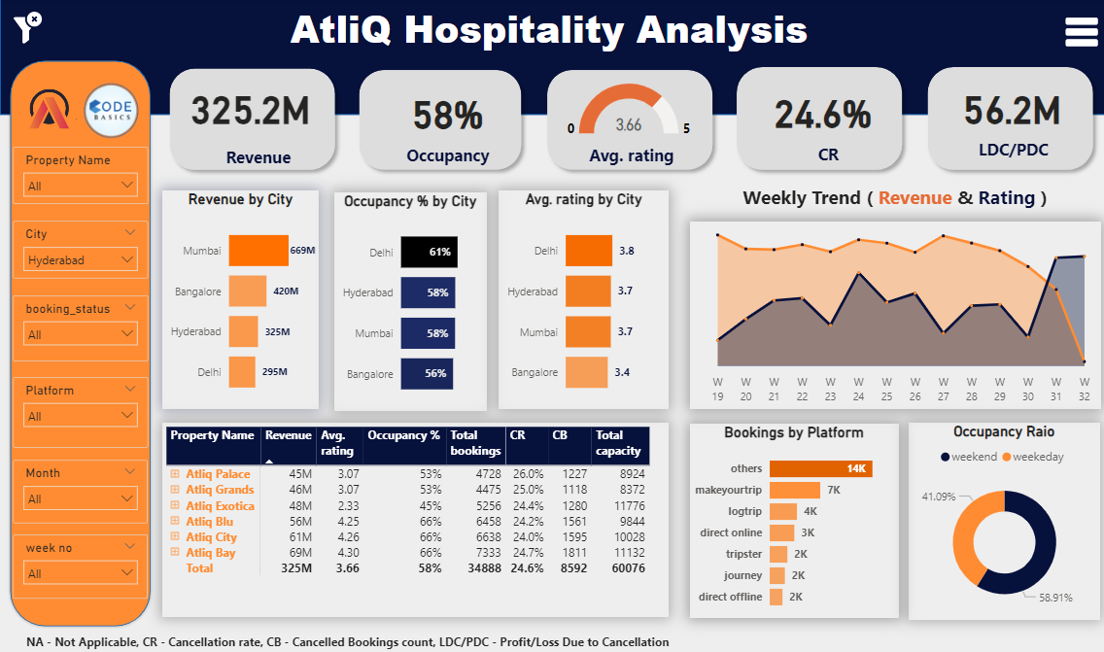
Overview of the Project

Slide 7
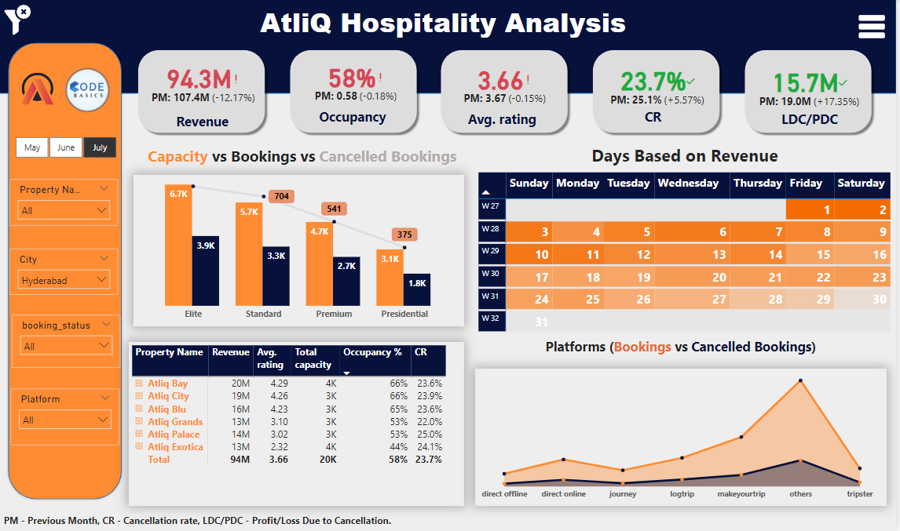
Monthly Analysis of Data

Slide 8
Learnt things from this Project
Learnt to build a new visual (Calendar Visual) using matrix table, which can be utilized for different purpose of analyze. (Article referred)
By referring different cancellation polices followed by different hotels, understood that most of the hotels charge zero fees, only if the booking is cancelled before three months of booking date. If the booking is cancelled after that, the charge from 60 to 90% of the booking cost.
Tried using color palette and stick with that colors throughout the dashboard (Color palette link)

Slide 9
Some Important Insights of the Project
Mumbai generates the highest revenue (669 M) followed by Bangalore, Hyderabad and Delhi.
AtliQ Exotica performs better compared to all 7 type of properties with 320 Million revenue rating 3.62, occupancy percentage 57 and cancellation rate as 24.4%.
AtliQ Bay has the highest occupancy of 66%.
Week 24 recorded the highest revenue among all, which is 139.6 Million.
Delhi tops both in occupancy and rating followed by Hyderabad, Mumbai, Bangalore.
AtliQ lost around 298 Million in cancellation.
Elite type rooms has the most booking and as well higher cancellation rate.

Slide 10
Thank You
Detailed Project Report Submitted by
Deepak Gupta

